Slide 1
Anonymity, Security, Privacy, and Civil Liberties
From: Ethical and social issues in the Information Age
Book of Kizza

Slide 2
Objectives to be able to:
Legally summarize the right to privacy and freedom of expression
Critically analyze stated security procedures
Propose appropriate security measures for different situations
Describe current computer-based threats to privacy
distinguish between proper and improper use of internet tools for freedom of expression.
Describe and suggest solutions for trends facing privacy as the technology develops.

Slide 3
Introduction
There is nowhere to run … nowhere to hide . Personal privacy is dead .
Every student describes his digital activity during last week. The student then tabulates the activities in terms of time, type, third party, privacy safeguard (y/n) , third party codes and terms of ethics, relevant advertisements received during last week, third party scoring, self scoring
Eg.

Slide 4
Example: who is reading my bills?
Day | time | activity | Third party | transaction | Membership/discount card | Privacy safeguard | Service provider codes of ethics | # or relevant received ads after purchase | scoring
M | 9:00 a.m | buying food | Danube | Visa/Bank, cash | e.g. Iktisab | y/n | NA | 3 | = no of adds/ activities

Slide 5
Why they are interested in me?
Information is a treasure
Liabilities
High demand
Increased competition
Increased awareness
Increased digitization and smartization

Slide 6
Possibility: Anonymity
Pseudo identity
Student no
Pseudo address
Untraceable identity

Slide 7
Anonymity in the internet
Anonymous servers
Via encryption
Anonymous users
Simple Mail Transfer Protocol (SMTP) and
Network News Transfer Protocol (NNTP),

Slide 8
During class discussion
Safeguarding privacy
• Legislation
• Regulation
• Self-help
Do they work?
What do you think is the best way to safeguard privacy?
How much privacy are you willing to give up/tolerate to feel secure?

Slide 9
Pros and cons of anonymity
Pros:
National security
Whistle blowing:
e.g. unhealthy, illegal activities.
Avoiding intimidation
Self interest
Cons
Personal and societal harm, especially through social media.
Complicates investigations on disputes and crimes.
Q: is there any about who shall legally use anonymity in KSA? How this impact the freedom of internet?

Slide 10
Security

Slide 11
Why do we need security?
To prevent
unauthorized access
Unauthorized use
Theft
Physical damage to digital properties

Slide 12
Security domains
Confidentiality:
means of preventing unauthorized disclosure to third parties
Integrity: preventing unauthorized modification of files and maintaining the existing situation.
Includes : system, information, and personal integrity
Availability: preventing unauthorized withholding of information and facility (from and when needed)
To prevent

Slide 13
Types of encryption
Physical Security
prevention of access to physical facilitates(e.g. computer Systems)
Defense mechanisms
Deterrence : create an atmosphere which defend against intruder access
Prevention: stop intruder access.
Detection: assume access and monitor who and what intruder is doing
Response: analyze and minimize damage.
Physical access control by:
Physical security barriers: fences, dogs, sonsors, CCTVs, etc
Electronic access control: cards, firewalls and passwords
Packet filters firewalls
Proxy servers
Stateful inspection (filter + proxy)
Information security
prevention of access to information by encryption, authentication, and other means.
Encryption = cryptography ➔ symmetric, asymmetric and hah functions.

Slide 14
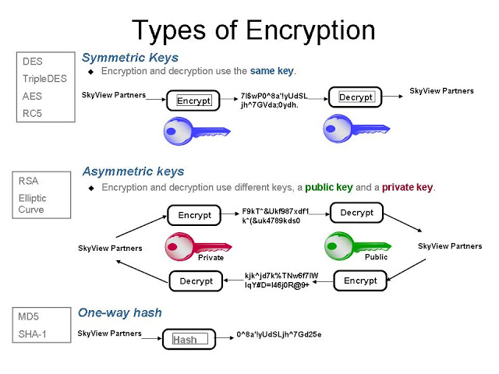
Types of encryptions (2)

Slide 15
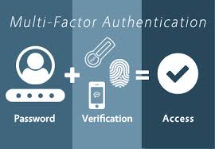
Authentication
System gathers information about the user and validates them to assure genuine user access.
Ensuring message integrity
Digital signature
Tools
Username, password
Retinal image
Fingerprint
Physical locality
Identity cards
Etc.

Slide 16
Authentication versus authorization
Authentication
Verify that I am whom I claim
Login
http authentication
Certificate
Authorization
Decides if you have permission to access a resource
Access control via URL
Access control lists
Secure methods

Slide 17
Security Policy
A document specifying
organizational security guidelines which are mandatory for all members to follow.
Guidelines about how to handle security incidents.
Example 1: Information Security policy for using KSU domain?
Example 2: policies and procedures
Sample security policy for a financial organization
Sample security policy of a health institution
Sample security policy for a governmental organization
Sample security policy for a software product

Slide 18
Privacy

Slide 19
Definitions
The ability of individuals or groups to hide or selectively express themselves or information about themselves.
A human value with the following rights:
Solitude : The right to be alone without disturbances حق العزلة
Anonymity : The right to have no public personal identity اخفاء الهوية عن العامة
Intimacy : The right not to be monitored
Reserve : The right to control one’s personal information including the methods of dissemination of that information
Durlak J Privacy and security. Communications for tomorrow. http://renda.colunato.yorku.ca/com4tom/1296.html
Relative in culture, locality, religion, political system, …etc.

Slide 20
Types of privacy
Personal privacy
All personal attributes
US fourth amendment
right of the people to be secure in their persons, houses, papers, and effects, against unreasonable searches and seizures.
"ولا تجسسوا"
Information privacy
Preventing unauthorized access to
Personal information
Financial information
Medical information
Internet activity
Institutional privacy
Protecting research data, product data, sales data, marketing strategies, ..etc.

Slide 21
Importance of privacy
Guards our personal identity
Preserves our autonomy
Supports establishing new social relationships
How these attributes are violated?!
Technology, national address, national id, iqama ,etc,
Challenging autonomy
Search on other-side information (marriage)
Internet crawlers gather information on us without our consent

Slide 22
Privacy acts and policies
They restrict illegal and harmful privacy violation
Privacy policy :
the institution is bound to tell us the nature, type, usage of information about us.
Right to opt out :
the institution is bound to explain our recourse to prevent the transfer of our data to third-party beneficiaries
Safeguards :
the institution must put in place policies to prevent fraudulent access to confidential information

Slide 23
Legal issues in privacy violations
Privacy violations are now widespread. We are victims on daily bases due to
Inadequate privacy policies
Giving up little or more information when shopping, responding to ads, etc.
Failure of companies to commit and follow up their own privacy policies
Internet temptation
Intrusion: wrongful entry, seizing, or acquiring possession of the property of others.
Misuse of information
Interception of information
Information matching

Slide 24
Privacy protection
Technical
Do not reveal personal information inadvertently.
Turn on cookie notices in your Web browser, and/or use cookie management, software or informdiaries.
Keep a “clean” email address.
Don’t reveal personal details to strangers or just-met “friends.”
Realize you may be monitored at work.
Use encryption
Contractual
Type and dissemination
Legal
Protection acts
Children, family, consumer, etc
Freedom of information
Privacy
Financial privacy
Financially services
Search the internet on possible Saudi Acts available to protect privacy.
Ethics

Slide 25
Reading
Chapter 5 of the book

Slide 26
Questions
De fi ne security and privacy. Why are both important in the information age?
What is anonymity? Discuss two forms of anonymity.
Discuss the importance of anonymity on the Internet.
Develop two scenarios—one dealing with ethical issues involving security and the other dealing
with ethical issues involving privacy.
List and discuss the major threats to individual privacy.
Identity theft is the fastest growing crime. Why?
Suggest steps necessary to protect personal identity.
Anonymity is a doubly edged sword. Discuss.
Modern day information mining is as good as gold! Why or why not?
How do consumers unknowingly contribute to their own privacy violations?

